Slide 1
COMP 4311 Programming Languages
Dr. Lening Wang

Slide 2

Who am I?
Dr. Lening (Lenny) Wang
Assistant professor @ CS, PVAMU
Email: lenwang@pvamu.edu
Office: SR Collins Engineering Building, Room 313
Class Hour: MWF: 2pm – 2.50pm.
Office Hours: MW: 10pm – 11am; W: 3pm – 4pm; and by appointment

Slide 3
How to get an “A” in this class
Attend class regularly
Do the homework independently
Read the textbook
Study hard!

Slide 4
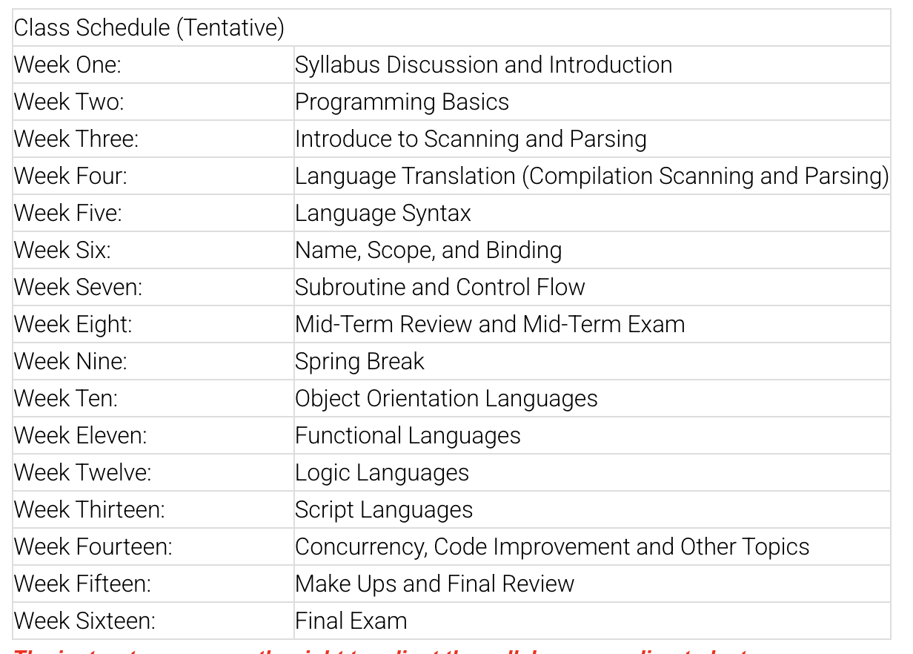
Class Schedule (Tentative)

Slide 5
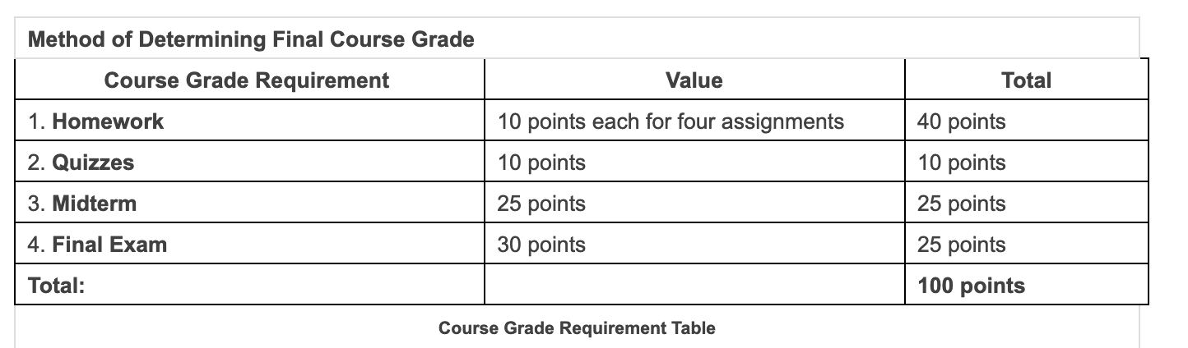
Method of Determining Final Grades

Slide 6
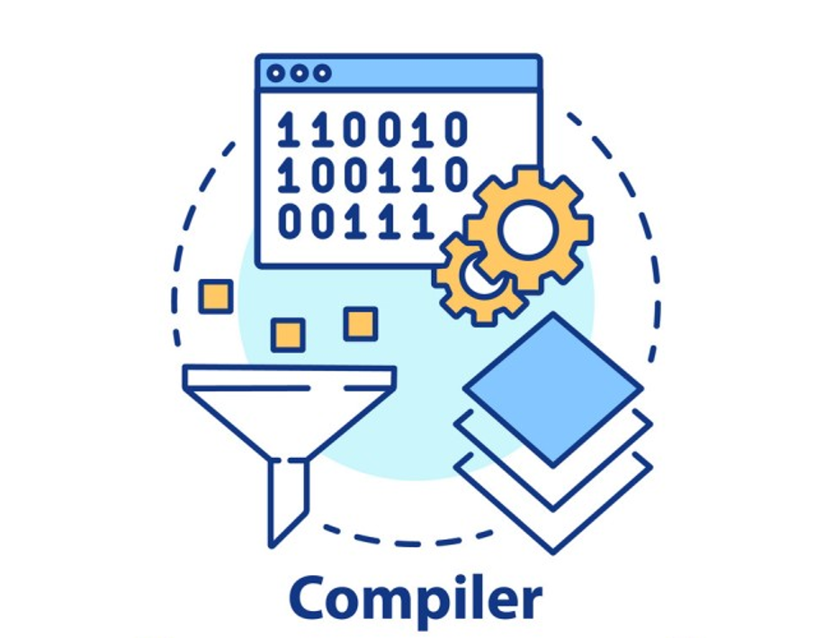
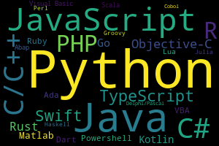
Overview of this course

Slide 7
Goal of this course
Our Goal:
Design/Implement of Programming Language
Feature of Language
Overview of Language
Choice of Language
Not Our Goal:
History of Language
Teach all Language
Algorithm Course
Design a Complier

Slide 8

Chapter 1 :: Introduction
Programming Language Pragmatics, Fourth Edition
Michael L. Scott
Copyright © 2016 Elsevier

Slide 9
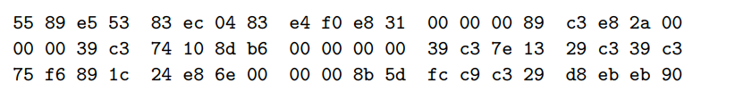
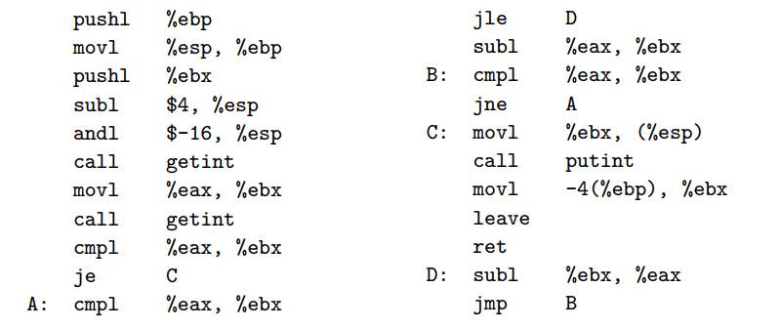
Introduction

Slide 10
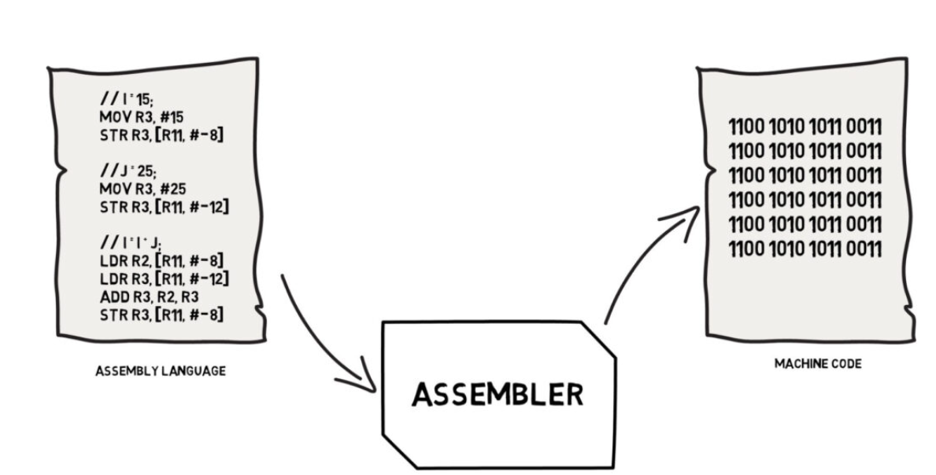
Introduction

Slide 11
Introduction
Machine-centered to Human-centered
People began to wish for a machine-independent language, could be expressed in something more closely resembling mathematical formulae.
Translating from a high-level language to assembly or machine language is the job of a systems program known as a compiler. (we’ll talk later)

Slide 12
Introduction
Why are there so many programming languages?
  evolution -- we've learned better ways of doing things over time
  special purposes -- some languages were designed for a specific problem domain.
  orientation toward special hardware – Verilog for FPGA
  personal preference -- diverse ideas about what is pleasant to use

Slide 13
Introduction
What makes a language successful?
  easy to learn (BASIC, Pascal, LOGO, Scheme)
  easy to express things, easy use once fluent, "powerful”
(C, Common Lisp, APL, Algol-68, Perl)
  easy to implement (BASIC, Forth)
  possible to compile to very good (fast/small) code (Fortran)
  backing of a powerful sponsor (COBOL, PL/1, Ada, Visual Basic)
  Open source, standardization and etc.,

Slide 14
Introduction
Why do we have programming languages? What is a language for?
  way of thinking -- way of expressing algorithms
  languages from the user's point of view
  languages from the implementor's point of view
  abstraction of virtual machine -- way of specifying what you want
  the hardware to do without getting down into the bits

Slide 15
Why study programming languages?
Help you choose a language.
  C vs. C++ vs. C# for systems programming
  Fortran vs. C for numerical computations
  PHP vs. Ruby for web-based applications
  Ada vs. C for embedded systems
  Common Lisp vs. Scheme vs. ML for symbolic data manipulation
  Java vs. .NET for networked PC programs

Slide 16
Why study programming languages?
Make it easier to learn new languages.
Some languages are similar; easy to walk down family tree.
  concepts have even more similarity; if you think in terms of iteration, recursion, abstraction (for example), you will find it easier to assimilate the syntax and semantic details of a new language.
  Think of an analogy to human languages: good grasp of grammar makes it easier to pick up new languages.

Slide 17
Why study programming languages?
Help you make better use of whatever language you use
  understand obscure features:
    In C, help you understand unions, arrays & pointers, separate compilation, varargs, catch and throw
    In Common Lisp, help you understand first-class functions/closures, streams, catch and throw, symbol internals

Slide 18
Why study programming languages?
Help you make better use of whatever language you use (2)
  understand implementation costs: choose between alternative ways of doing things, based on knowledge of what will be done underneath:
    use simple arithmetic equal (use x*x instead of x**2)
    use C pointers or Pascal "with" statement to factor address calculations
    avoid call by value with large data items in Pascal
    avoid the use of call by name in Algol 60
    choose between computation and table lookup (e.g. for
cardinality operator in C or C++)

Slide 19
Why study programming languages?
Help you make better use of whatever language you use (3)
  figure out how to do things in languages that don't support them explicitly:
    lack of suitable control structures in Fortran
    use comments and programmer discipline for control structures
    lack of recursion in Fortran, CSP, etc
    write a recursive algorithm then use mechanical recursion elimination

Slide 20
Why study programming languages?
Help you make better use of whatever language you use (4)
  figure out how to do things in languages that don't support them explicitly:
    lack of named constants and enumerations in Fortran
    use variables that are initialized once, then never changed
    lack of modules in C and Pascal use comments and programmer discipline
    lack of iterators in just about everything fake them with (member?) functions

Slide 21
Imperative languages
Group languages as
  Imperative (specifies and directs the control flow of the program)
    von Neumann
    object-oriented
    scripting languages
  Declarative (specifies the expected result and core logic)
    functional
    logic, constraint-based
(Fortran, Pascal, Basic, C) (Smalltalk, C++, JAVA)
(Perl, Python, JavaScript, PHP)
(Scheme, ML, pure Lisp, FP)
(Prolog, VisiCalc, SQL)

Slide 22
Imperative languages
Imperative languages, particularly the von Neumann languages, predominate
– They will occupy the bulk of our attention
We also plan to spend a lot of time on functional, logic languages

Slide 23
Check list:
What is the difference between machine language and assembly language?
In what way(s) are high-level languages an improvement on assembly language?
Why are there so many programming languages?
What makes a programming language successful?
What distinguishes declarative languages from imperative languages?

Slide 24
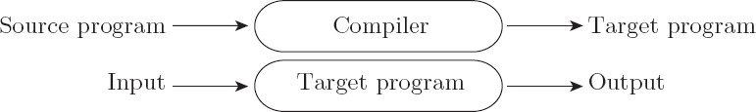
Compilation vs. Interpretation
Compilation vs. interpretation
  not opposites
  not a clear-cut distinction
Pure Compilation
  The compiler translates the high-level source program into an equivalent target program (typically in machine language), and then goes away:

Slide 25

Compilation vs. Interpretation
Pure Interpretation
  Interpreter stays around for the execution of the program
  Interpreter is the locus of control during execution

Slide 26
Compilation vs. Interpretation
Interpretation:
  Greater flexibility
  Better diagnostics (error messages)
Compilation
  Better performance
Think about the Human Translation Example!

Slide 27
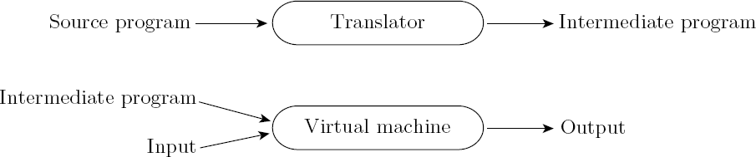
Compilation vs. Interpretation
Common case is compilation or simple pre- processing, followed by interpretation
Most language implementations include a mixture of both compilation and interpretation

Slide 28
A virtual machine (VM) is a software-based emulation of a physical computer that runs programs as if they were executed on real hardware. A VM often refers to an environment where code is executed, typically after being compiled into an intermediate representation (like bytecode).
Many programming languages (e.g., Java, Python, and C#) do not compile directly to machine code. Instead, they compile to an intermediate representation (e.g., Java bytecode or .NET MSIL).This intermediate code is executed on a virtual machine, which acts as a software abstraction of a real CPU.
Portability: Write once, run anywhere (e.g., Java programs can run on any system with a JVM).
Safety: VMs can enforce strict runtime checks to prevent dangerous operations.
Flexibility: Code can run in different environments without modification.

Slide 29
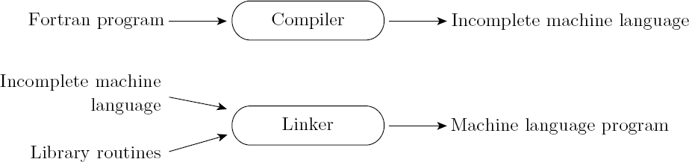
Compilation vs. Interpretation
Implementation strategies:
  Library of Routines and Linking
    Compiler uses a linker program to merge the appropriate library of subroutines (e.g., math functions such as sin, cos, log, etc.) into the final program:

Slide 30
A linker is a program or tool that combines multiple object files (produced by a compiler) and libraries into a single executable file.
It resolves symbol references (e.g., function calls, variable definitions) between different parts of the program.
Once a compiler generates object files (e.g., .o or .obj files), these contain machine code but may have unresolved references (e.g., a function in one file that is called from another).
Linker's Job:
Combine all object files into a single executable.
Resolve references between symbols (e.g., finding the memory address of a function or variable).
Include necessary code from external libraries (static or dynamic).

Slide 31
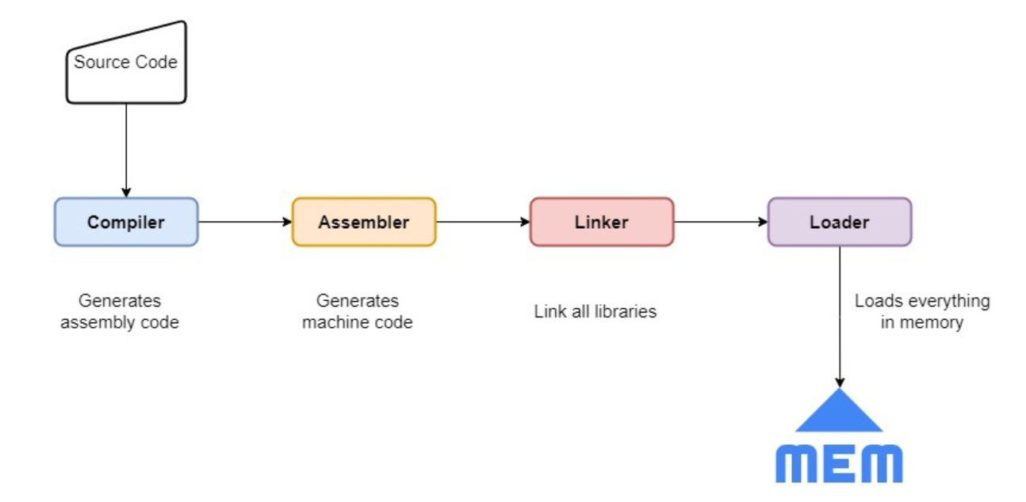
Compilation vs. Interpretation

Slide 32
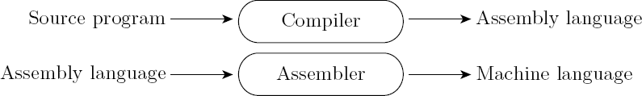
Compilation vs. Interpretation
Implementation strategies:
  Post-compilation Assembly
    Facilitates debugging (assembly language easier for people to read)
    Isolates the compiler from changes in the format of machine language files (only assembler must be changed, is shared by many compilers, pc, phone, embeded system…)

Slide 33
Assembler: Converts low-level assembly language into machine-specific code, forming part of the traditional compilation pipeline (source → assembly → machine code → executable).
VM: Executes or interprets intermediate code, providing abstraction, portability, and runtime features for high-level languages.

Slide 34
Compilation vs. Interpretation
Implementation strategies:
  Preprocessor
    Removes comments and white space
    Groups characters into tokens (keywords, identifiers, numbers, symbols)
    Expands abbreviations in the style of a macro assembler
    Identifies higher-level syntactic structures (loops, subroutines)

Slide 35
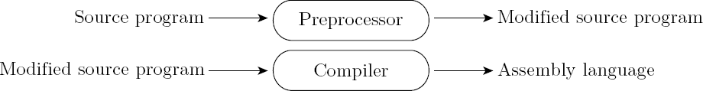
Compilation vs. Interpretation
Implementation strategies:
  The C Preprocessor (conditional compilation)
    Preprocessor deletes portions of code, which allows several versions of a program to be built from the same source

Slide 36
Compilation vs. Interpretation
Note that compilation does NOT have to produce machine language for some sort of hardware
Compilation is translation from one language into another, with full analysis of the meaning of the input (key difference from pre-processing)
Compilation entails semantic understanding of what is being processed; pre-processing does not
A pre-processor will often let errors through. A compiler hides further steps; a pre-processor does not

Slide 37
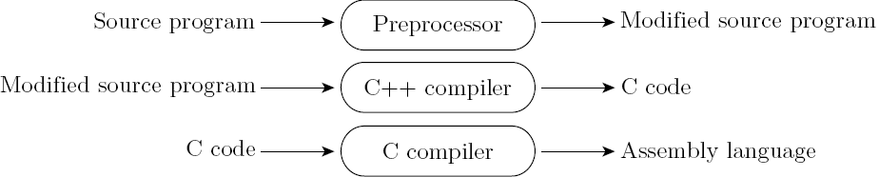
Compilation vs. Interpretation
Implementation strategies:
  Source-to-Source Translation (C++)
    C++ implementations based on the early AT&T compiler generated an intermediate program in C, instead of an assembly language:
Is it another preprocessor to C compiler?

Slide 38
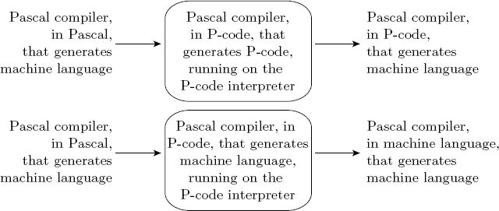
Compilation vs. Interpretation
Implementation strategies:
– Bootstrapping

Slide 39
Compilation vs. Interpretation
Implementation strategies:
  Compilation of Interpreted Languages
    The compiler generates code that makes assumptions about decisions that won’t be finalized until runtime. If these assumptions are valid, the code runs very fast. If not, a dynamic check will revert to the interpreter.

Slide 40
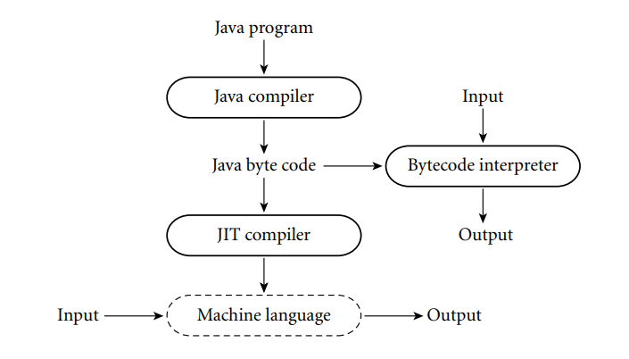
Compilation vs. Interpretation
Implementation strategies:
  Dynamic and Just-in-Time Compilation
    In some cases a programming system may deliberately delay compilation until the last possible moment.
      The Java language definition defines a machine-independent intermediate form known as byte code. Byte code is the standard format for distribution of Java programs.

Slide 41
Compilation vs. Interpretation
Implementation strategies:
  Microcode
    Assembly-level instruction set is not implemented in hardware; it runs on an interpreter.
    Interpreter is written in low-level instructions (microcode or firmware), which are stored in read- only memory and executed by the hardware.

Slide 42
IDE (integrated development environment)
Integrated with editor, complier and interpreter;
The editor for an IDE may incorporate knowledge of language syntax, providing templates for all the standard control structures, and checking syntax as it is typed in;
Likely to maintain not only a program’s source and object code, but also a partially compiled internal representation.
When the source is edited, the internal representation will be updated automatically.

Slide 43
Chapter 1: Introduction of PL
Language evaluation criteria
Main implementation methods
Trade-offs
Influences on language design

Slide 44
Evaluating A Language
4 main criteria:
  Readability
  Writability
  Reliability
  Cost

Slide 45
Evaluation: Readability
The most important criterion
Overall simplicity
  Too many features is bad
  Multiplicity of features is bad
Orthogonality
  Makes the language easy to learn and read
  Meaning is context independent
Control statements
Data type and structures
Syntax considerations

Slide 46
Evaluation: Writability
Factors:
  Simplicity and orthogonality
  Support for abstraction
  Expressivity

Slide 47
Evaluation: Reliability
Factors:
  Type checking
  Exception handling
  Aliasing
  Readability and writability

Slide 48
Evaluation: Cost
Categories
  Programmer training
  Software creation
  Compilation
  Execution
  Compiler cost
  Poor reliability
  Maintenance
Other criteria?

Slide 49
Implementation Methods
Compilation
  Translate high-level program to machine code
  Slow translation
  Fast execution
Pure interpretation
  No translation
  Slow execution
  Becoming rare
Hybrid implementation systems
  Small translation cost
  Medium execution speed

Slide 50
Language Design Trade-offs
Reliability versus cost of execution
Writability versus readability
Flexibility versus safety

Slide 51
Primary influences on language design
1. Computer architecture
  We use imperative languages, at least in part, because we use von Neumann machines
2. Programming methodologies
  1950s and early 1960s: Simple applications; worry about machine efficiency
  Late 1960s: People efficiency became important; readability, better control structures
  Late 1970s: Data abstraction
  Middle 1980s: Object-oriented programming

Slide 52
An Overview of PL History
1950
1960
1970
1980
1990
2000
1950’s: Discovery and description
1960’s: Elaboration and analysis
1970’s: Technology
1980’s: New paradigms
1990’s: Internet influences

Slide 53
1950’s: Discovery and Description
FORTRAN
LISP
1950
1960
1970
1980
1990
2000
FORTRAN (54-57, and on and on):
  First widely used compiled language
  Relatively efficient
LISP (56-62):
  First functional language, first support for recursion, activation records, run-time stack
  First garbage collector, implicit dynamic memory mgmt.
  Interpreter-based

Slide 54
1960’s: Elaboration and Analysis
ALGOL
COBOL
SNOBOL
APL
BASIC
PL/I
1950
1960
1970
1980
1990
2000
ALGOL 58, 60: first universal language. NEW: BNF, block structure, call-by-value, stack-based evaluation, stack-based arrays
APL: applicative, no precedence, interpreted
COBOL:English-style syntax, records in files
BASIC: interactive time-sharing terminals
SNOBOL: pattern matching
PL/I: the kitchen sink

Slide 55
1970’s: Technology
Pascal
Modula-2
Smalltalk
SIMULA 67
C
Prolog
1950
1960
1970
1980
1990
2000
SIMULA 67: classes, inheritance, data abstraction
Pascal: small, elegant, structured programming, teaching
C: systems programming, efficiency
Modula-2: Pascal + modules, better for systems programming
Prolog: first logic language, AI-oriented
Smalltalk: pure OO, interpreted, entire system

Slide 56
1980’s: New Paradigms
Ada
SML
C++
1950
1960
1970
1980
1990
2000
Ada: DoD, long committee-based development, large & complex, packages, tasks, generics, exceptions, from real-time to payroll apps.
C++: OOP in a popular, widespread language, often seen as a “hybrid”
Standard ML, Hope, Miranda, Haskell: functional languages

Slide 57
1990’s: Internet Influences
Perl
Java
1950
1960
1970
1980
1990
2000
Scripting: Perl, TCL, Visual Basic, JavaScript, Python, …
Java: designed for portable binaries and internet use, “clean” OO compared to C++, garbage collection, compiled/interpreted hybrid

Slide 58
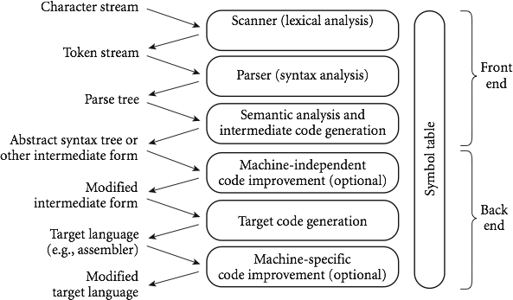

An Overview of Compilation
Phases of Compilation

Slide 59
Lexical Analysis (Tokenization):
The compiler's lexer (or scanner) reads the source code and breaks it down into tokens. Tokens are the basic building blocks of a language, such as keywords, operators, identifiers, and literals.
This process involves removing whitespace, comments, and breaking the code into a sequence of tokens.

Slide 60
Syntax Analysis (Parsing):
In this stage, the parser analyzes the tokens to determine their syntactic structure according to the rules of a Context-Free Grammar.
The result is usually a parse tree (or syntax tree), which represents the syntactic structure of the token sequence.

Slide 61
Semantic Analysis:
Semantic analysis involves checking the parse tree for semantic errors, ensuring that the code follows the rules of the programming language.
This includes type checking, verifying expressions and assignments are semantically correct, and enforcing scope rules.

Slide 62
An Overview of Compilation
Scanning:
  divides the program into "tokens", which are the smallest meaningful units; this saves time, since character-by-character processing is slow
  we can tune the scanner better if its job is simple; it also saves complexity (lots of it) for later stages
  you can design a parser to take characters instead of tokens as input, but it isn't pretty
  scanning is recognition of a regular language, e.g., via DFA

Slide 63
An Overview of Compilation
Parsing is recognition of a context-free language, e.g., via PDA
  Parsing discovers the "context free" structure of the program
  Informally, it finds the structure you can describe with syntax diagrams (the "circles and arrows" in a Pascal manual)

Slide 64
An Overview of Compilation
Semantic analysis is the discovery of meaning
in the program
  The compiler actually does what is called STATIC semantic analysis. That's the meaning that can be figured out at compile time
  Some things (e.g., array subscript out of bounds) can't be figured out until run time. Things like that are part of the program's DYNAMIC semantics

Slide 65
An Overview of Compilation
Intermediate form (IF) done after semantic analysis (if the program passes all checks)
  IFs are often chosen for machine independence, ease of optimization, or compactness (these are somewhat contradictory)
  They often resemble machine code for some imaginary idealized machine; e.g. a stack machine, or a machine with arbitrarily many registers
  Many compilers actually move the code through more than one IF

Slide 66
An Overview of Compilation
Optimization takes an intermediate-code program and produces another one that does the same thing faster, or in less space
  The term is a misnomer; we just improve code
  The optimization phase is optional
Code generation phase produces assembly language or (sometime) relocatable machine language

Slide 67
An Overview of Compilation
Certain machine-specific optimizations (use of special instructions or addressing modes, etc.) may be performed during or after target code generation
Symbol table: all phases rely on a symbol table that keeps track of all the identifiers in the program and what the compiler knows about them – This symbol table may be retained (in some form) for
use by a debugger, even after compilation has completed

Slide 68
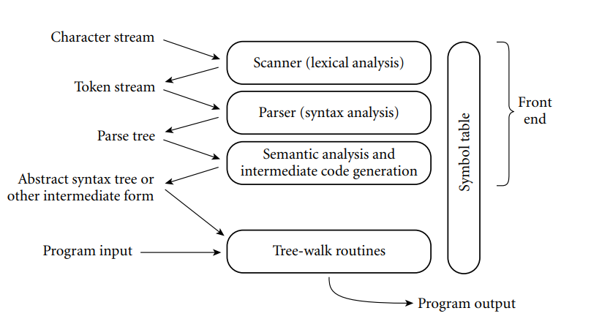
An Overview of Compilation
Phases of Interpretation

Slide 69
An Overview of Compilation
Lexical and Syntax Analysis
– GCD Program (in C)
int main() {
int i = getint(), j = getint(); while (i != j) {
if (i > j) i = i - j; else j = j - i;
}
putint(i);
}

Slide 70
An Overview of Compilation
Lexical and Syntax Analysis
  GCD Program Tokens
    Scanning (lexical analysis) and parsing recognize the structure of the program, groups characters into tokens, the smallest meaningful units of the program
int | main | ( | ) | {
int | i | = | getint | ( | ) | , | j | = | getint | ( | ) ;
while | ( | i | != | j | ) | {
if | ( | i | > | j | ) | i | = | i | - | j | ;
else | j | = | j | - | i | ;
}
putint | ( | i | ) | ;
}

Slide 71
An Overview of Compilation
Lexical and Syntax Analysis
  Context-Free Grammar and Parsing
    Parsing organizes tokens into a parse tree that represents higher-level constructs in terms of their constituents
    Potentially recursive rules known as context-free grammar define the ways in which these constituents combine

Slide 72
An Overview of Compilation
Context-Free Grammar and Parsing
– Example (while loop in C)
iteration-statement → while ( expression ) statement
statement, in turn, is often a list enclosed in braces:
statement → compound-statement
compound-statement → { block-item-list opt }
where
block-item-list opt → block-item-list
or
block-item-list opt → ϵ
and
block-item-list → block-item
block-item-list → block-item-list block-item block-item → declaration
block-item → statement

